Slide 1

Running Job on RCC systems using the SLURM Scheduler
Raj Shukla and Parmanand Sinha
July 21, 2020
rcc.uchicago.edu

Slide 2

Agenda
The RCC Midway compute systems
Using Slurm (Simple Linux Utility for Resource Management) to submit jobs to the RCC Midway systems
=> Goals of this workshop
Learn the basics of Slurm
Be comfortable submitting jobs on a Midway HPC systems
Understand queue priority
Be comfortable checking if jobs succeeded/failed
Know how to fix common errors

Slide 3

Understanding the RCC Compute Ecosystem
Midway is a constellation a of many compute systems and storage with various architectures coupled
together in one system.
Slurm is the software used to manage the workload on Midway
Let us begin...

Slide 4
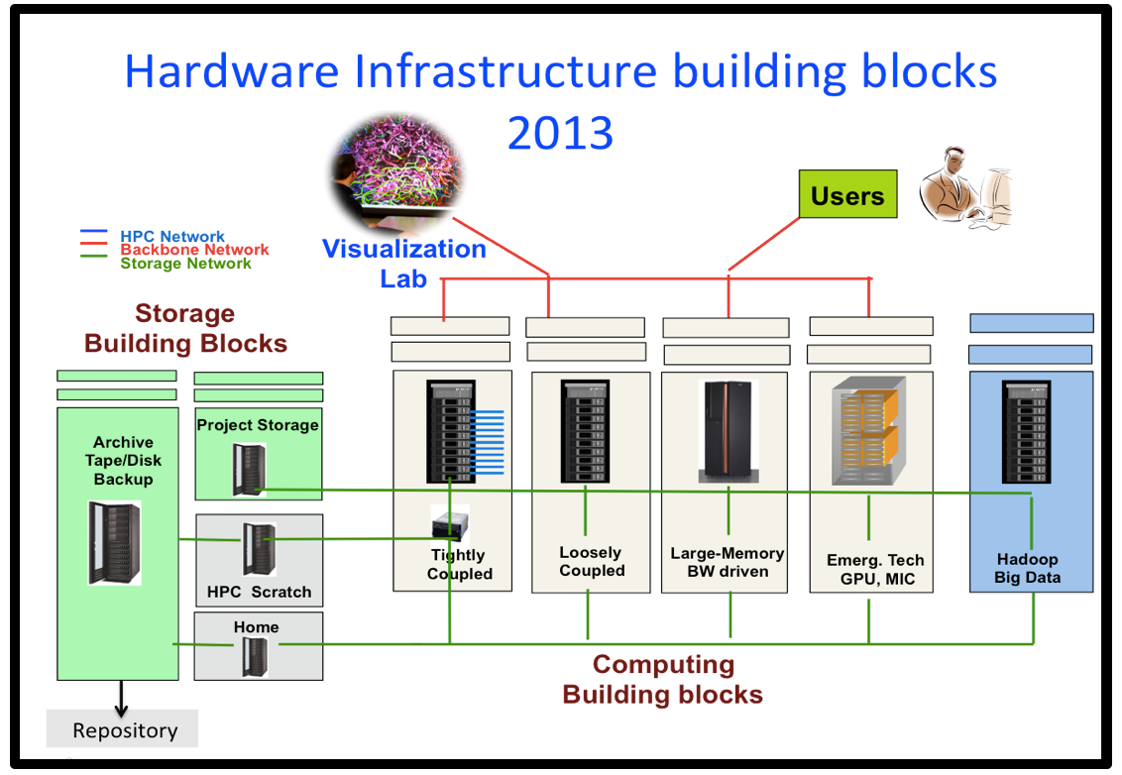
CDS Storage
Capacity Storage

Slide 5
Some definitions
A processor is a small chip that responds to and processes the basic instructions that drive a computer. The term processor is used interchangeably with the term central processing unit (CPU)
Core: The smallest compute unit that can run a program
Socket: A compute unit, packaged as one and usually made of a single chip often called processor. Modern sockets carry many cores (10, 14, or 20, 24, 28, etc. on most servers)
Node: A stand-alone computer system that contains one or more sockets, memory, storage, etc. connected to other nodes via a fast network interconnect.
Notes:
A processor, or "microprocessor," is a small chip that resides in computers and other electronic devices. Its basic job is to receive input and provide the appropriate output. ... The central processor of a computer is also known as the CPU, or "central processing unit.” The central processor of a computer is also known as the CPU, or "central processing unit." This processor handles all the basic system instructions

Slide 6

From a CPU to a Cluster
CPU
Motherboard
(Has Multiple cores)
Socket
(Can have Multiple CPUs)
Cabinet
Compute Node
Cluster
Rack

Slide 7
Distributed vs Shared Memory Systems
P1
P2
P1
Mem 2
P2
P
P
P
Mem 2
P
Shared Memory
Mem 1
Mem 2
Node1
Network
Node2
P
Mem 3
P
P
Mem 4
P
Node3
Node4
Distributed Shared Memory
Supercomputing Institute
for Advanced Computational Research

Slide 8

The RCC compute cluster
Computing hardware
367 nodes total
342 tightly coupled Broadwell nodes ( 10,360 cores)
Two intel E5-2680v4 processors per node (14 core/proc)
155 nodes have EDR network card
187 nodes have FDR network card
6 NVidia Tesla K80 GPU nodes (4 GPU cards/node)
5 large shared memory nodes (512GB each)
14 dual socket loosely-coupled Broadwell nodes
Cluster Partnership Program: 1000+ nodes
900+ tightly coupled infiniband nodes
20+ Big memory nodes
100+ Nvidia GPU nodes
RCC Manages 1515 nodes
(35,904 cores)

Slide 9
RCC Hardware: Midway2 (Shared)
Cores(Nodes) | CPU | Memory | Network
5236 (187) | 2.4GHz Intel Broadwell | 64GB | EDR 100Gbit/s InfiniBand
4,340 (155) | 2.4GHz Intel Broadwell | 64GB | FDR14 56Gbit/s InfiniBand
140 (5) | 2.4GHz Intel Broadwell | 512GB | FDR14 56Gbit/s InfiniBand
504 (14) | 2.4GHz Intel Broadwell | 64GB | 1 GigE
Cores (Nodes) | CPU Accelerator | Memory | Network
168 (6) | 2.4GHz Intel Broadwell NVIDIA Tesla K80 | 128GB | FDR14 56bit/s InfiniBand
Notes:
FDR 4x 40 Gbit/s
Sandyb: Intel Xeon CPU E5-2670 @ 2.60GHz – cores: 8 – HT disabled - cache: 20MB– socket: LGA2011
Westmere: Intel Xeon CPU X5675 @ 3.07GHz – cores: 6 – HT disabled – cache: 12MB – socket: ZIF Socket
AMD: Abu Dhabi AMD Opteron(tm) Processor 6386 SE
Sandybridge: IBM System X iDataPlex dx360 M4 Server
Westmere: IBM System X iDataPlex dx360 M3 Server
Bigmem: IBM System x3650 M4
AMD: Dell PowerEdge R815
448TC
96LC
----- Meeting Notes (9/13/13 15:38) -----
fix 32gb memory
sandyb in phi nodes
fix keplar spelling
bigmem03
bigmem has 48 cores?
partition flag

Slide 10
RCC Hardware: Midway2 (Shared)
Cores(Nodes) | CPU | Memory | Slurm Queue
5180 (185) | 2.4GHz Intel Broadwell | 64GB | broadwl
5180 (185) | 2.4GHz Intel Broadwell | 64GB | broadwl
168 (6) | 2.4GHz Intel Broadwell | 512GB | bigmem2
504 (18) | 2.4GHz Intel Broadwell | 64GB | broadwl-lc
Cores (Nodes) | CPU Accelerator | Memory | Queue
168 (6) | 2.4GHz Intel Broadwell NVIDIA Tesla K80 | 128GB | gpu2
Notes:
FDR 4x 40 Gbit/s
Sandyb: Intel Xeon CPU E5-2670 @ 2.60GHz – cores: 8 – HT disabled - cache: 20MB– socket: LGA2011
Westmere: Intel Xeon CPU X5675 @ 3.07GHz – cores: 6 – HT disabled – cache: 12MB – socket: ZIF Socket
AMD: Abu Dhabi AMD Opteron(tm) Processor 6386 SE
Sandybridge: IBM System X iDataPlex dx360 M4 Server
Westmere: IBM System X iDataPlex dx360 M3 Server
Bigmem: IBM System x3650 M4
AMD: Dell PowerEdge R815
448TC
96LC
----- Meeting Notes (9/13/13 15:38) -----
fix 32gb memory
sandyb in phi nodes
fix keplar spelling
bigmem03
bigmem has 48 cores?
partition flag

Slide 11
Schematic of the Midway Cluster
There are about more than 1300+ nodes compute
nodes on midway2, but only 2 login nodes for
Debugging.

Slide 12
Midway2 Storage
High Capacity storage: /project2
3.8 PB of storage
Backed up to tape system
7 daily and 4 weekly snapshots located at /snapshots/project2
7 day grace period on over quota
High Performance storage: /scratch/midway2
190 TB usable
Not backed up
100 GB user soft quota
30 day grace period on over quota
Home directory space: /home
61 TB of capacity
Each user has 30 GB quota
7 day grace period on over quota
7 daily and 2 weekly snapshots located at /snapshots/home
12

Slide 13
How to
Run jobs at RCC
Either Interactively or submitting jobs to a queue using Slurm

Slide 14
Repository
Please clone the repo at
https://github.com/rcc-uchicago/SLURM_WORKSHOP.git

Slide 15
Running Interactive jobs
login directly to a node
Login to midway2.rcc.uchicago.edu
Run the job at the command prompt
Run interactively using sinteractive
Uses Slurm to provide access to dedicated node(s) to which you can login directly
To use sinteractive:
sinteractive --time=01:00:00 --nodes=1
--ntasks=2 --mem-per-cpu=1000
–-partition=broadwl

Slide 16
A Key point to remember
There are about more than 1300+ nodes compute nodes on midway2, but only 2 login nodes.
This means you are sharing the login nodes with many other users at once. Running intensive programs on the login nodes causes the login nodes to be slow for all other users.
login nodes are for editing files, compiling, moving files, changing permissions, and other non-intensive tasks.
We recommend to use sinteractive for interactive runs
For long running jobs => submit them to the queue

Slide 17
sinfo –s
Summary of partitions on Midway2
NODES(A/I/O/T) : Nodes (Allocated/Idle/Other/Total)
e.g: To check the Broadwl partition: sinfo –s |grep broadwl

Slide 18
Slurm: Some key terms to remember
A job is the resources you are using and the code you are running
The queue in Slurm is all RUNNING and all PENDING jobs To see every job in the queue on Oscar, use the command
squeue
To see your jobs in the queue
squeue –u <cnetid>
or
myq

Slide 19
What goes into a batch script?
A batch script is list of instructions for slurm.
#!/bin/bash
# Here is a comment
#SBATCH --time=1:00:00
#SBATCH –nodes=1
#SBATCH –ntasks-per-node=1
#SBATCH --mem-per-cpu=2000
#SBATCH –job-name=MyJob
#SBATCH –output= MyJob-%j.out
#SBATCH –error=MyJob-%j.err
module load <module name>
#Run your code

Slide 20
What goes into a batch script?
A batch script is list of instructions for slurm.
#!/bin/bash
# Here is a comment
#SBATCH --time=1:00:00
#SBATCH –nodes=1
#SBATCH –ntasks-per-node=1
#SBATCH --mem-per-cpu=2000
#SBATCH –job-name=MyJob
#SBATCH –output= MyJob-%j.out
#SBATCH –error=MyJob-%j.err
module load <module name>
#Run your code
This #! is a shebang
It tells operating system to use /bin/bash
with this script

Slide 21
What goes into a batch script?
A batch script is list of instructions for slurm.
#!/bin/bash
# Here is a comment
#SBATCH --time=1:00:00
#SBATCH –nodes=1
#SBATCH –ntasks-per-node=1
#SBATCH --mem-per-cpu=2000
#SBATCH –job-name=MyJob
#SBATCH –output= MyJob-%j.out
#SBATCH –error=MyJob-%j.err
module load <module name>
#Run your code
# is a comment
everything after # is ignored by bash

Slide 22
What goes into a batch script?
A batch script is list of instructions for slurm.
#!/bin/bash
# Here is a comment
#SBATCH --time=1:00:00
#SBATCH –nodes=1
#SBATCH –ntasks-per-node=1
#SBATCH --mem-per-cpu=2000
#SBATCH –job-name=MyJob
#SBATCH –output= MyJob-%j.out
#SBATCH –error=MyJob-%j.err
module load <module name>
#Run your code
#SBATCH is a directive
It is a comment in Bash
#SBATCH is only relevant to slurm:
sbatch my_script.sh

Slide 23
What goes into a batch script?
A batch script is list of instructions for slurm.
#!/bin/bash
# Here is a comment
#SBATCH --time=1:00:00
#SBATCH –nodes=1
#SBATCH –ntasks-per-node=1
#SBATCH --mem-per-cpu=2000
#SBATCH –job-name=MyJob
#SBATCH –output= MyJob-%j.out
#SBATCH –error=MyJob-%j.err
module load <module name>
#Run your code
#SBATCH is a directive
It is a comment in Bash
#SBATCH is only relevant to slurm:
sbatch my_script.sh
To comment out directives, break the pattern, e.g.
##SBATCH
# SBATCH

Slide 24
What goes into a batch script?
A batch script is list of instructions for slurm.
#!/bin/bash
# Here is a comment
#SBATCH --time=1:00:00
#SBATCH –nodes=1
#SBATCH –ntasks-per-node=1
#SBATCH --mem-per-cpu=2000
#SBATCH –job-name=MyJob
#SBATCH –output= MyJob-%j.out
#SBATCH –error=MyJob-%j.err
module load <module name>
#Run your code
Instructions for Slurm must go at the top of the script
Any #SBATCH lines you put after your program will be ignored

Slide 25
What goes into a batch script?
A batch script is list of instructions for slurm.
#!/bin/bash
# Here is a comment
#SBATCH --time=1:00:00
#SBATCH –nodes=1
#SBATCH –ntasks-per-node=1
#SBATCH --mem-per-cpu=2000
#SBATCH –job-name=MyJob
#SBATCH –output= MyJob-%j.out
#SBATCH –error=MyJob-%j.err
module load <module name>
#Run your code
Slurm has some variables you can use. %j is the job number. When the job runs %j will be expanded to the job number. In this example %j is used in the output file and error file names:
MyJob-13571056.out
MyJob-13571056.err
%j is unique. By using %j in your filenames you guarantee a unique file name, which means you won’t accidentally overwrite previous output.

Slide 26
What goes into a batch script?
A batch script is list of instructions for slurm.
#!/bin/bash
# Here is a comment
#SBATCH --time=1:00:00
#SBATCH –nodes=1
#SBATCH –ntasks-per-node=1
#SBATCH --mem-per-cpu=2000
#SBATCH –job-name=MyJob
#SBATCH –output= MyJob-%j.out
#SBATCH –error=MyJob-%j.err
module load <module name>
#Run your code
=> Time your job is allowed to run
=> Number of nodes to run on
=> Number of cores on each node to use
=> Memory per cpu => 2000Mb or 2Gb
=> Name of the job.
=> Job output file behaves as stdout for the code.
=> Error file. behaves as stderr for the code.
=> Load any modules you need for your application
=> run the code you want

Slide 27
Running batch jobs using a Submission Script
A simple job submission script (saved as python.sbatch):
#!/bin/bash
#SBATCH --job-name=first_python_job
#SBATCH --output=first_python_job_%j.out
#SBATCH --error=first_python_job_%j.err
#SBATCH --nodes=1
#SBATCH --ntasks-per-node=1
#SBATCH --mem-per-cpu=2000M
#SBATCH --partition=broadwl
#SBATCH --reservation=kicpworkshop-cpu
#SBATCH --time=00:30:00
module load python
python hello_world.py
echo “job finished at `date`”
• To submit the above script:
sbatch python.sbatch
Slurm
Your Job

Slide 28
Please do the Exercise; Ex-1 in Repo

Slide 29
How to submit OpenMP jobs?
#!/bin/bash
#Here is a comment
#SBATCH --time=1:00:00
#SBATCH –partition=broadwl
#SBATCH –nodes=1
#SBATCH –ntasks-per-node=8
#SBATCH --mem-per-cpu=2000
#SBATCH –job-name=MyJob
#SBATCH –output= MyJob-%j.out
#SBATCH –error=MyJob-%j.err
module load <module name>
export OMP_NUM_THREADS=8
#Run your code
./my_executable
Specify number of cores > 1.
OMP_NUM_THREADS is an environment variable.

Slide 30
Please do the Exercise; Ex-2 in Repo

Slide 31
How to submit Parallel MPI jobs?
#!/bin/bash
#Here is a comment
#SBATCH --time=1:00:00
#SBATCH –job-name=MyJob
#SBATCH –output= MyJob-%j.out
#SBATCH –error=MyJob-%j.err
#SBATCH –partition=broadwl
#SBATCH –nodes=4
#SBATCH –ntasks-per-node=8
#SBATCH --mem-per-cpu=2000
module load openmpi
module load <module name>
#Run your code
mpirun ./my_executable
Specify number of nodes > 1.
Specify number of cores >= 1.
Load OPENMPI MPI library or IntelMPI

Slide 32
Please do the Exercise; Ex-3 in Repo

Slide 33
How to submit GPU jobs?
#!/bin/bash
#Here is a comment
#SBATCH --time=1:00:00
#SBATCH –partition=gpu2
#SBATCH –gres=gpu:1
#SBATCH –nodes=1
#SBATCH –ntasks-per-node=8
#SBATCH --mem-per-cpu=2000
#SBATCH –job-name=MyJob
#SBATCH –output= MyJob-%j.out
#SBATCH –error=MyJob-%j.err
module load <module name>
#Run your code
./my_executable
Specify partition gpu2
Specify number of gpus, like gpu:1

Slide 34
Please do the Exercise; Ex-4 in Repo

Slide 35
How to submit MPI + GPU jobs?
CUDA Aware MPI

Slide 36
How to submit MPI + GPU jobs?
Compilation
Job Submission

Slide 37
Please do the Exercise; Ex-5 in Repo

Slide 38
How to submit MPI + OpenMPI jobs?

Slide 40
Please do the Exercise; Ex-5a in Repo

Slide 41
How to submit array based jobs
#!/bin/bash
# Job Name
#SBATCH --job-name=arrayjob
# Walltime requested
#SBATCH --time=0:10:00
#Add partition
#SBATCH --partition=broadwl-lc
# Provide index values (TASK IDs)
#SBATCH --array=1-16
# Use '%A' for array-job ID, '%J' for job ID and '%a' for task ID
#SBATCH --error=maths%A-%a.err
#SBATCH --output=maths%A-%a.out
# single core
#SBATCH --ntasks-per-node=1
#SBATCH --mem-per-cpu=2000
# Use the $SLURM_ARRAY_TASK_ID variable to provide different inputs for each job
input=$((SLURM_ARRAY_TASK_ID*1000+2))
echo "Running job array number: "$SLURM_ARRAY_TASK_ID "input " $input
Notes:
In this simple example, --array=1-16 requests 16 array tasks (numbered 1 through 16). The “array tasks” are copies of the master script that are automatically submitted to the scheduler on your behalf. In each array task, the environment variable SLURM_ARRAY_TASK_ID is set to a unique value (in this example, numbers ranging from 1 to 16).

Slide 42
Please do the Exercise; Ex-6 in Repo

Slide 43
How to submit dependent jobs
SLURM Rule:
sbatch --dependency=type:job_id jobfile

Slide 44
Please do the Exercise; Ex-7 in Repo
How to submit dependent jobs
after | This job can begin execution after the specified jobs have begun execution
afterany | This job can begin execution after the specified jobs have terminated.
aftercorr | A task of this job array can begin execution after the corresponding task ID in the specified job has completed successfully
afternotok | This job can begin execution after the specified jobs have terminated in some failed state
afterok | This job can begin execution after the specified jobs have successfully executed
singleton | This job can begin execution after any previously launched jobs sharing the same job name and user have terminated

Slide 45
How to submit Parallel batch jobs
#!/bin/sh
#SBATCH --time=01:00:00
#SBATCH --partition=broadwl
#SBATCH --ntasks=28
#SBATCH --mem-per-cpu=2G # NOTE DO NOT USE THE --mem= OPTION
# Load the default version of GNU parallel. module load parallel
# set the max number of processes (which determine the max per processor)
ulimit -u 10000
# This specifies the options used to run srun. The "-N1 -n1" options are
# used to allocates a single core to each task.
srun="srun --exclusive -N1 -n1”
#Run GNU parallel
parallel="parallel --delay 0.2 -j $SLURM_NTASKS --joblog runtask.log --resume" # Run a script, runtask.sh, using GNU parallel and srun.
$parallel "$srun ./runtask.sh arg1:{1} > runtask.sh.{1}" ::: {1..128}
# Note that if your program does not take any input, use the -n0 option to call the parallel command: # # $parallel -n0
"$srun ./run_noinput_task.sh > output.{1}" ::: {1..128}

Slide 46
Please do the Exercise; Ex-8 in Repo
How to submit Parallel batch jobs

Slide 47
What resources should I ask for?
This depends on the code you are running

Slide 48
What resources should I ask for?
This depends on the code you are running

Slide 49
What resources should I ask for?
This depends on the code you are running
Nodes/Cores
Question: is your code parallel? You will need to find out if your code can
Run on multiple cores? Run across multiple nodes?
Check if your code is threaded, multiprocessor, MPI
Question: Is your code serial?
This means it can only make use of one core

Slide 50
What resources should I ask for?
This depends on the code you are running
Wall Time
Make an estimate of your job run and add a bit.
e.g. if think your code will take an hour, give it 1 hour and 30 min
If your job runs out of time, your job will be killed, so
be accurate with your estimate without going below.

Slide 51
What resources should I ask for?
This depends on the code you are running
Memory
For memory, this can take some trial and error. You can ask for a lot, then measure your usage. If you have asked for more memory and then reduce your memory with the next job.
To ask for all the memory available on a node, use #SBATCH --mem=0

Slide 52
What if I need an entire node or specific features?
Add this in your batch script
#SBATCH –exclusive
Add this in your batch script
#SBATCH –constraint=v100

Slide 53
How do I know the features of the node to use with #SBATCH -constraint?
nodestatus
Features

Slide 54
What resources should I ask for?
This depends on the code you are running
GPUs If you code is build to use gpus you can submit to the gpu partition. To request 1 gpu:
#SBATCH -p gpu2 --gres=gpu:1
Notes:
gres=gpu: how many GPUs you want to use

Slide 55
What resources did my job actually use?
It is good practice to occasionally check what resources your job is using. For example if you are going to be submitting hundreds of similar jobs, you may save yourself a lot of waiting time in the queue by checking that you are not over requesting resources. Midway2 has a script to display the resources a job used:
jobinfo -j 99999
Replace 99999 with the job ID of the job you are interested in.

Slide 56
Why did my job fail?
Ran out of Memory
Ran out of Time
Problem in your submit script
Problem with your code
Node failure

Slide 57
Why did my job fail?
Ran out of Memory
Ran out of Time
Problem in your submit script
Problem with your code
Node failure
You can fix these

Slide 58
Why did my job fail?
Ran out of Memory
Ran out of Time
Problem in your submit script
Problem with your code
Node failure
=> For node failure – please email help@rcc.uchicago.edu, if this happens
You can fix these

Slide 59
Job Priority
Priority is calculates using a Fairshare algorithm
Fairshare is function of
Requested wall clock, memory, nodes/cores, etc.
Length of time in queue
Number of jobs in a time window and per PI group
Backfill
Etc.

Slide 60
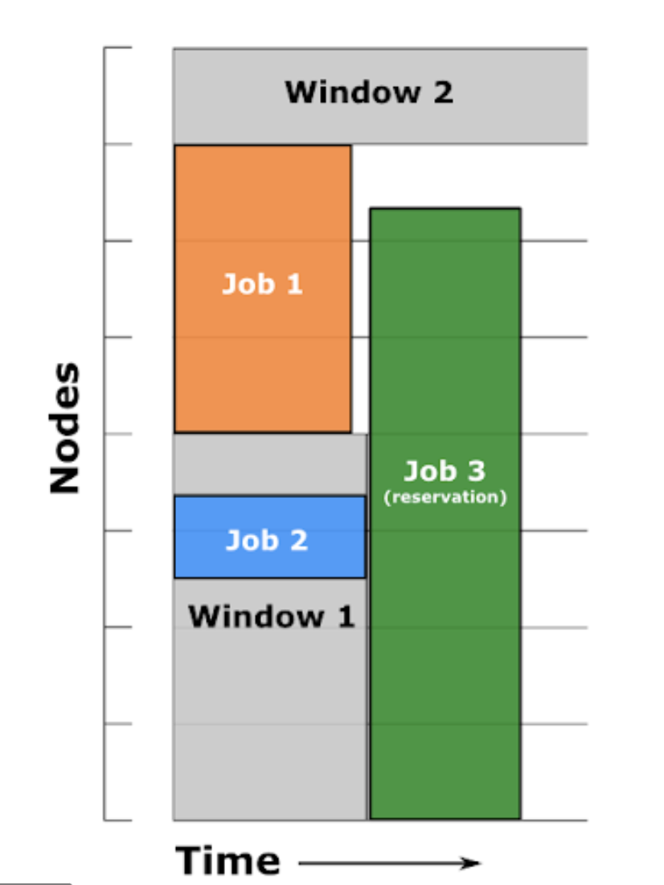
Job Priority
Backfill
This blue line represents all the cores on Midway
the x axis is time
time

Slide 61
Job Priority
Backfill
Why has someone else’s job started before mine?
The scheduler can fit smaller jobs in before big jobs are due to start
# of Cores on Midway
Job1
Job2
Job3
time

Slide 62
Job Priority
Backfill
Why has someone else’s job started before mine?
Job4 while requesting less nodes, it can not be backfilled because it needs to run longer
# of Cores on Midway
Job1
Job2
Job3
Job4
time

Slide 63
Job Priority
Backfill
Why has someone else’s job started before mine?
You can take advantage of backfill by specifying wall time as accurately as you can. Job 5 has done this.
# of Cores on Midway
Job1
Job2
Job3
Job5
Job4
time

Slide 64
Job Priority
Backfill
Why has someone else’s job started before mine?
You can take advantage of backfill by specifying wall time as accurately as you can. In this example job 4 could have run much earlier if a more accurate estimate of the time was used.
# of Cores on Midway
Job1
Job2
Job3
Job5
Job4
time

Slide 65
Job submission and monitoring
SLURM Commands
Command | Description
sbatch script.sbatch | Submits script.sbatch job script
squeue –u $USER or myq | Reports the status of your jobs
sacct –u $USER | Displays accounting data for your job(s)
scancel jobid | Cancels a running job or removes it from the queue
scontrol show job jobid or jobinfo | Displays details of a running job
Notes:
Scontrol show job jobid: will tell you the history of the job, when you submitted the job, how many resources the job used, etc.

Slide 66
Recommended online resources
User guide on running jobs on Midway
https://rcc.uchicago.edu/docs/running-jobs/index.html
Details Slurm documentation
https://slurm.schedmd.com/sbatch.html
SLURM Cheat Sheet
https://slurm.schedmd.com/pdfs/summary.pdf

Slide 67
RCC Help
Contact:
By email: help@rcc.uchicago.edu
Web: rcc.uchicago.edu
Phone: 773-795-2667
In person:
5607 S Drexel Avenue
Regenstein – Room 216
Workshops and Tutorials:
http://rcc.uchicago.edu/services/training.html
A bottom–up approach to supporting research computing

Slide 68
Thank You!

